Slide 1
20CS2220RA
Design and Analysis of Algorithms
Session – 13
Knapsack Problem
Prepared by
Dr. Venu Babu Rachapudi

Slide 2










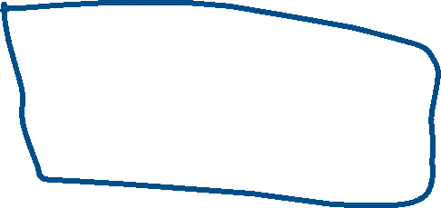







Knapsack Problem
We are give n objects and a knapsack or bag .
Object i has a weight w_{i} and the knapsack has a capacity m.
If a fraction x_{i ,} 0 <x_{i} < 1, of object i is placed into the knapsack, then a profit of p_{i} x_{i} is earned.
The objective is to obtain a filling of the knapsack that Maximizes the total profit earned.

Slide 3
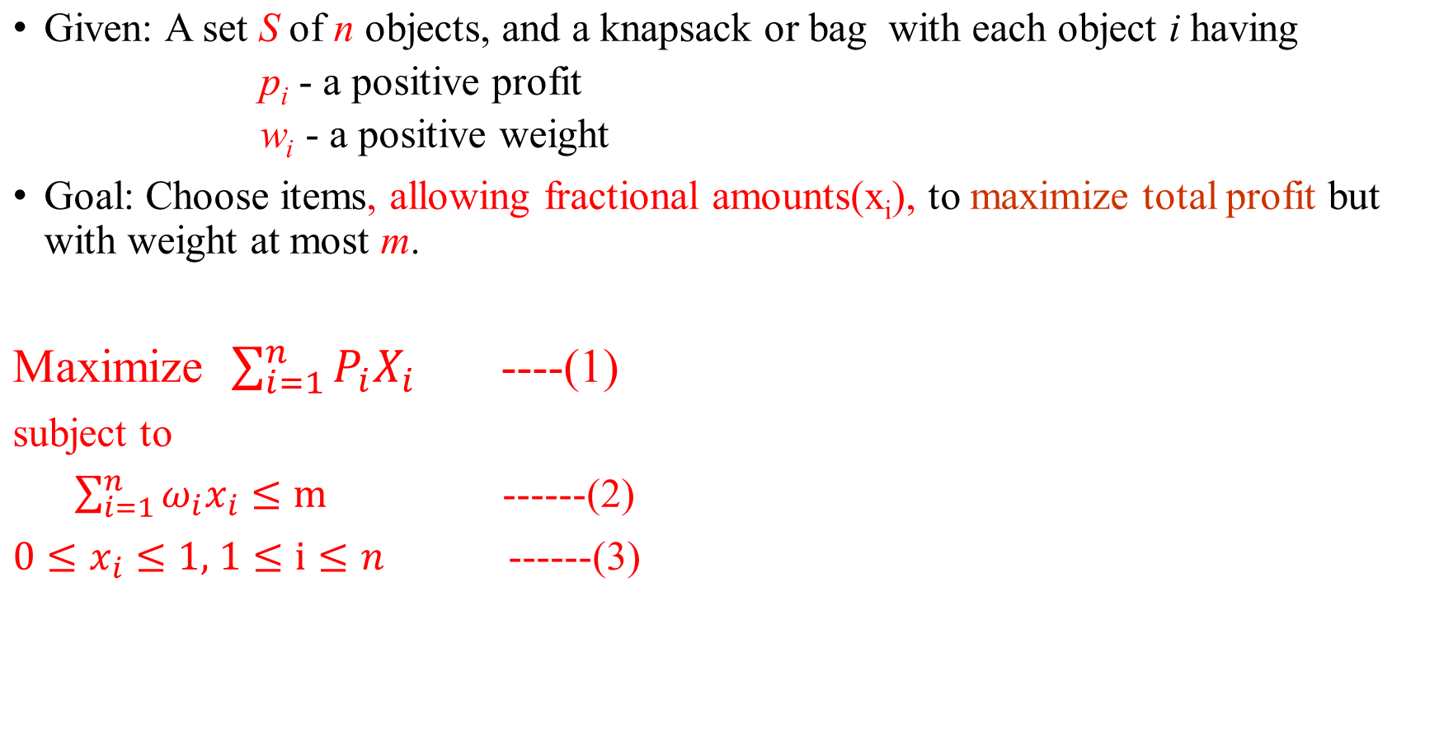
Mathematical Representation

Slide 4



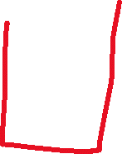



















Example 1:
Consider the following instance of the knapsack problem
n= 3, m=20,(p₁,p₂,p₃) = (25,24,15) and (w₁,w₂,w₃) = (18,15,10)
Solution:1
Randomly selected
Selection Vector (x₁,x₂,x₃) : (1/2,1/3,1/4)
∑ w_{i}x_{i} = ( 1/2 *18+ 1/3 *15+1/4*10) = (9+5+2.5) = 16.5
Profit = ∑ p_{i}x_{i =} (1/2 *25+ 1/3 *24+1/4*15) = (12.5+8+3.75) = 24.25

Slide 5

Solution:2
Objects are arranged in decreasing order of profits : x₁,x₂,x₃
Selection Vector (x₁,x₂,x₃) : (1,2/15,0)
∑ w_{i}x_{i} = ( 1*18+ 2/15*15+0*10) = (18+2+0) = 20
Profit = ∑ p_{i}x_{i =} (1 *25+ 2/15 *24+0*15) = (25+3.2+0) = 28.2

Slide 6
Solution:3
Objects are arranged in increasing order of weights : x₃,x_{2,} x₁
Selection Vector (x₁,x₂,x₃) : (0,2/3,1)
∑ w_{i}x_{i} = ( 0*18+ 2/3*15+1*10) = (0+10+10) = 20
Profit = ∑ p_{i}x_{i =} (0 *25+ 2/3 *24+1*15) = (0+16+15) = 31

Slide 7






Solution:4
Objects are arranged in decreasing order of p_{i}/w_{i} : x_{2,} x₃, x₁
Selection Vector (x₁,x₂,x₃) : (0,1,1/2)
∑ w_{i}x_{i} = ( 0*18+ 1*15+1/2*10) = (0+15+5) = 20
Profit = ∑ p_{i}x_{i =} (0 *25+ 1 *24+1/2*15) = (0+24+7.5) = 31.5
Conclusion
Profit using Solution :1 is 24.25
Profit using Solution :2 is 28.2
Profit using Solution :3 is 31
Profit using Solution :4 is 31.5
The Optimal Solution is Solution :4

Slide 8





Greedy algorithm for the fractional Knapsack problem
1.Algorithm GreedyKnapsack(m, n)
2.//P[1:n] and w[1:n] contain the profits and weights respectively of the n objects
3.ordered such that p[i]/w[i] >= p[i+1]/w[i+1].
4.//m is the knapsack size and x[1:n] is the solution vector.
5.{
6. for i :=1 to n do x[i] := 0.0; // Initialize x.
7. U := m;
8. for i := 1 to n do
9. {
10. if ( w[i] > U ) then break;
11. if x[i] := 1; U := U - w[i];
12. }
13. if ( i <= n) then x[i] := U/w[i];
14. }

Slide 9
Time Complexity
The main time taking step is the sorting of all items in the decreasing order of their value / weight ratios.
If the items are already arranged in the required order, the while loop takes O(n) time.
Quick sort’s average time complexity is O(nlogn), therefore total time taken including the sort is O(nlogn)

Slide 10
EXAMPLE :
2:
Consider the following instance of the knapsack problem
n= 7, m=15,(, p₁,p₂,p₃ ,p₄,p₅,p₆,p₇) = (10,5,15,7,6,18,3) and
(w₁,w₂,w_{3,} w₄,w₅,w₆,w₇) = (2,3,5,7,1,4,1)

Slide 11
Thank You

